Slide 1
My Seat Space Summary

Slide 2
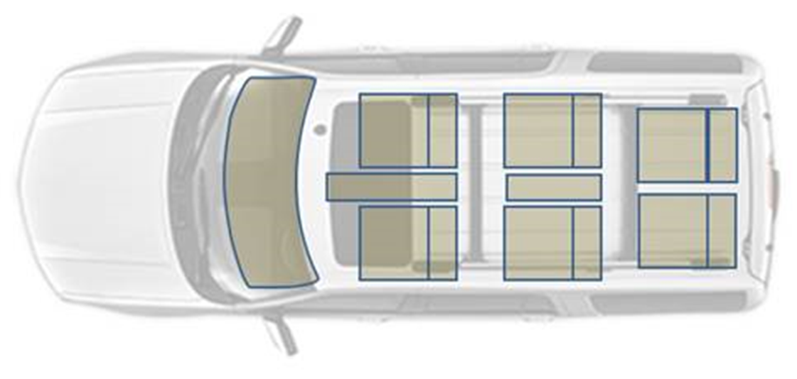
My Seat Space Experience – Description
The goal is to enhance each passengers’ entertainment and communication experience with:
Multiple simultaneous connections/controls
System allows for per zone personalized audio experiences
Audio and media streaming as well as private phone calls are contained to one seat/zone
Chimes and prompts can be sent to the appropriate seat without interrupting the entire vehicle
Media sharing and enhanced in-vehicle communication
Allows for improved two-way row-to-row communication by amplifying occupant speech
Allows for one-way communication for driver announcements
Users can share their media content with others in the vehicle
4 Zones
(4 media sources)
A
B
Zone 1
Zone 2
C
D
Zone 3
Zone 4
E
F

Slide 3
My Seat Space Experience – Use Cases
Use Cases
Audio can be split between driver, front passenger, left side (2nd and 3rd row) seats, and right side (2nd and 3rd ) row seats
Driver can simulate a two-zone configuration
Front Zone: The driver and front row passenger
Rear Zone: The second and third row
2 phone calls active at a time (never in adjacent seats) – other seats in zone continue with audio unless seat using URC is the one in the phone call (if so all other seats are muted)
Audio sharing between all (4) zones available
Mute speakers in a selected seat – mute does not cancel out bleed from other seats
Do Not Disturb – (Do not allow audio sharing requests)
In-Car Communication available: Ease of communication between the first and third rows by amplifying speech
Captain’s Announcement available: The ability for the driver to stop media throughout the vehicle and make an announcement
4 Zones
(4 media sources)
A
B
Zone 1
Zone 2
C
D
Zone 3
Zone 4
E
F

Slide 4
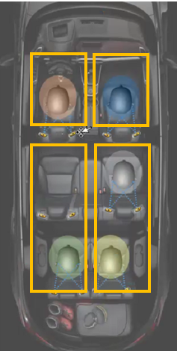
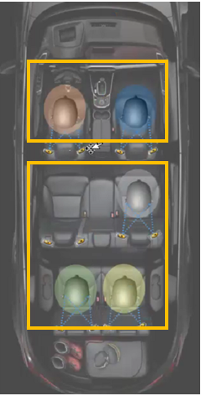
My Seat Space Zone – Audio Share
4 Zones w/ 2 Zone Shortcut
Virtually Simulates 2 Zones with HMI Interface Control, No back end changes
My Seat Space Experience – 4 Zone Scope Change
Four separate audio streams maximum
Driver has a 2 zone shortcut, locks the configuration
Passengers can stream/share audio from phones
Passengers accept/deny requests via URC
Driver accepts/denies requests via SYNC
Driver must accept any share request that would put the vehicle into Zone Mode
Third row passengers do not have audio sharing control
This includes phone calls via seat speakers
Team is successfully implementing 2 Zone Audio Share shortcut. Status is GREEN for J1.

Slide 5

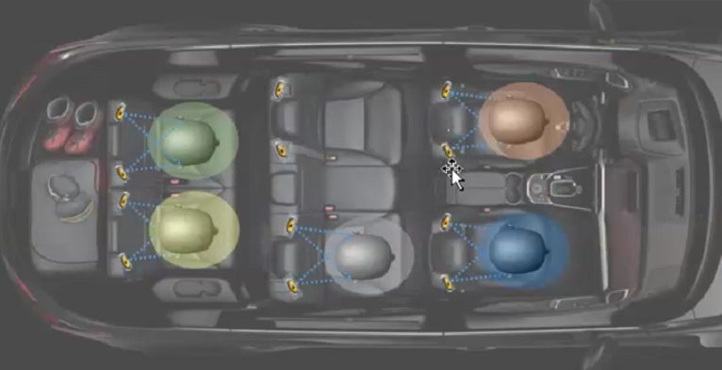

My Seat Space Zone – Phone Calls
4 Zones w/ 2 Zone Shortcut
Virtually Simulates 2 Zones with HMI Interface Control, No back end changes
My Seat Space Experience – 4 Zone Scope Change
Users can take a phone call within the seat speakers/microphone
Limiting 1 phone call via seat speakers per row
This limits the vehicle to 2 phone calls in seat speakers
Driver will have priority for the front row.
Second row phone calls will be first come, first serve
Anyone sharing music will stop sharing music for the duration of the phone call
Team has successfully developed the use cases for phone calls. Status is GREEN for J1.

Slide 6
My Seat Space Zone – In Car Communication
4 Zones w/ 2 Zone Shortcut
Virtually Simulates 2 Zones with HMI Interface Control, No back end changes
My Seat Space Experience – 4 Zone Scope Change
Activated/Deactivated via SYNC screen or URC
Only available in URC for first/third row passengers
Plays audio simultaneously with music
Front row speech only plays for third row, vice versa
Cannot work at the same time as phone calls/voice recognition
We would make ICC unavailable in this case
On/Off/Unavailable
Team has developed the use cases for In-Car Communication. Status is GREEN for J1.

Slide 7
My Seat Space Zone – Do Not Disturb
4 Zones w/ 2 Zone Shortcut
Virtually Simulates 2 Zones with HMI Interface Control, No back end changes
My Seat Space Experience – 4 Zone Scope Change
Passengers can activate DND via URC to stop share requests
This will prevent the driver from sharing to or changing the audio for a zone in DND
There are cases that still work for driver control
A “Driver Lock” is currently being discussed (similar to DND)
This allows the driver to prevent sharing to users w/o URC
Driver actions that still work
Push to Cabin
Turn off MSS
Lock out URC
Team is currently developing the use cases for Do Not Disturb. Status is GREEN for J1.

Slide 8
My Seat Space Experience – Video Streaming
There is expected to be a delay between the video and audio stream:
This delay occurs in vehicles today
The MSS System will process audio through more modules than today
6 total phones connected via Bluetooth
4 total phones potentially streaming audio
We need to test video streaming to confirm audio/video delay
4 Zones
(4 media sources)
A
B
Zone 1
Zone 2
C
D
Zone 3
Zone 4
E
F

Slide 9
My Seat Space – Positive vs. Negative Perspectives – CDX747 / U718 w/ Third Row Speakers
Positive Perspective:​
Personal listening experience
Seat speakers in every seat, allowing for an enhanced audio experience and the ability for the first row and second row to listen to individual sources.
Everyone is included in the journey:
Music sharing between most seats allows multiple centers of gravity in the vehicle (Via the center stack or my phone as a passenger)
In Car Communication – Carry on a conversation between the first and third row of the vehicle without having to shout. The media ducks; people can hear each other over their individual seat speakers
Full cabin audio is improved
Privacy modes:
Mute speakers in a selected seat so I can choose when I want to listen to music
Phone calls - The sound comes through the seat speakers so I can take private phone calls without disrupting the rest of the vehicle or having to put my phone up to my ear
Row to row Noise cancellation helps me to focus more on my own audio
Do Not Disturb – I’m not bombarded with notifications on my phone of people wanting to share music, I’m content listening to my preferred content
​
Negative Perspective:​
Personal listening experience
Audio bleeding and limited noise cancellation does not feel like a personal sanctuary, I am still hearing what everyone else is listening to
Everyone is included in the journey:
The 3rd row audio is linked to whatever the second row is playing, not useful or optimized for a 3rd row passenger
Privacy modes:
Individual mute does not cancel out the bleed from the other seats, I can still hear what others are listening to
Only 2 phone calls can be taken while in zone mode at a time, the rest of the calls go to the handset
No noise cancellation between adjacent seats so I can still hear what the person next to me is listening to

Slide 10
My Seat Space – Positive vs. Negative Perspectives – U718 w/o Third Row Speakers
Positive Perspective:​
Personal listening experience
Seat speakers in 1st and 2nd row, allowing for an enhanced audio experience and the ability for the first row and second row to listen to individual sources.
Everyone is included in the journey:
Music sharing between most seats allows multiple centers of gravity in the vehicle (Via the center stack or my phone as a passenger) (applicable to 1st and 2nd row)
In Car Communication – Carry on a conversation between the first and third row of the vehicle without having to shout. The media ducks; people can hear each other over their individual seat speakers
Full cabin audio is improved
Privacy modes:
Mute speakers in a selected seat so I can choose when I want to listen to music (applicable to 1st and 2nd row)
Phone calls - The sound comes through the seat speakers so I can take private phone calls without disrupting the rest of the vehicle or having to put my phone up to my ear (applicable to 1st and 2nd row)
Row to row Noise cancellation helps me to focus more on my own audio
Do Not Disturb – I’m not bombarded with notifications on my phone of people wanting to share music, I’m content listening to my preferred content (applicable to 1st and 2nd row)
​
Negative Perspective:​
Personal listening experience
Audio bleeding and limited noise cancellation does not feel like a personal sanctuary, I am still hearing what everyone else is listening to
Everyone is included in the journey:
There is no sound for the 3rd row passengers, they have to put in headphones otherwise they just hear the audio bleed from other seats
Privacy modes:
Individual mute does not cancel out the bleed from the other seats, I can still hear what others are listening to
Only 2 phone calls can be taken while in zone mode at a time, the rest of the calls go to the handset
No noise cancellation between adjacent seats so I can still hear what the person next to me is listening to

Slide 11
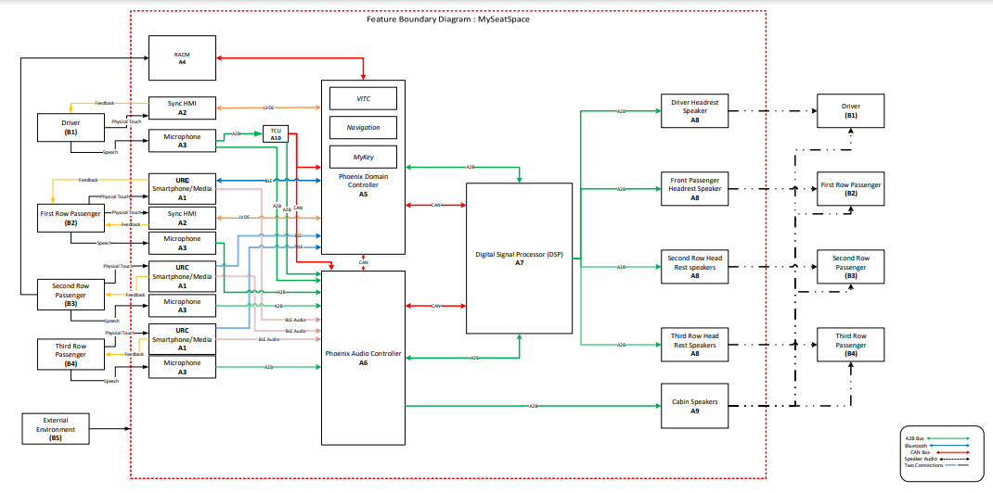
Boundary Diagram

Slide 12
Backup

Slide 13
UX and Program Status
Feature Owner Deliverable – Obtain UX Alignment
CDX74x – FD-9786 – Done 2/3/21. Confirmed Alignment with CIED. CIED PAT on 2/3/21
U71x – FD-40253 – Waived, Deliverable C/O
CIED ARL Released in FEDE - RQT-002004- 712583
Program Status
CDX74x – Yellow – On Target On 5D For UPV1 FO Deliverables. Specs Cascaded 8/13. UPV2 On Target
U6xx – NA – Program removed feature from Bill of Features
U71x – Green – C/O FO Deliverables Complete Through UPV0. ECU Handshake To Occur Week Of 8/16. UPV1 On Target
Latest Status

Slide 14
My Seat Space Zone Mode Options – Visual Comparison
Driver can push the zone configuration to 2 Zones

